Slide 1
Waste water experiment for pathogen and AMR surveillance
The goal is to study pathogens of interest in real wastewater samples by spiking them with synthetic reads.

Slide 2
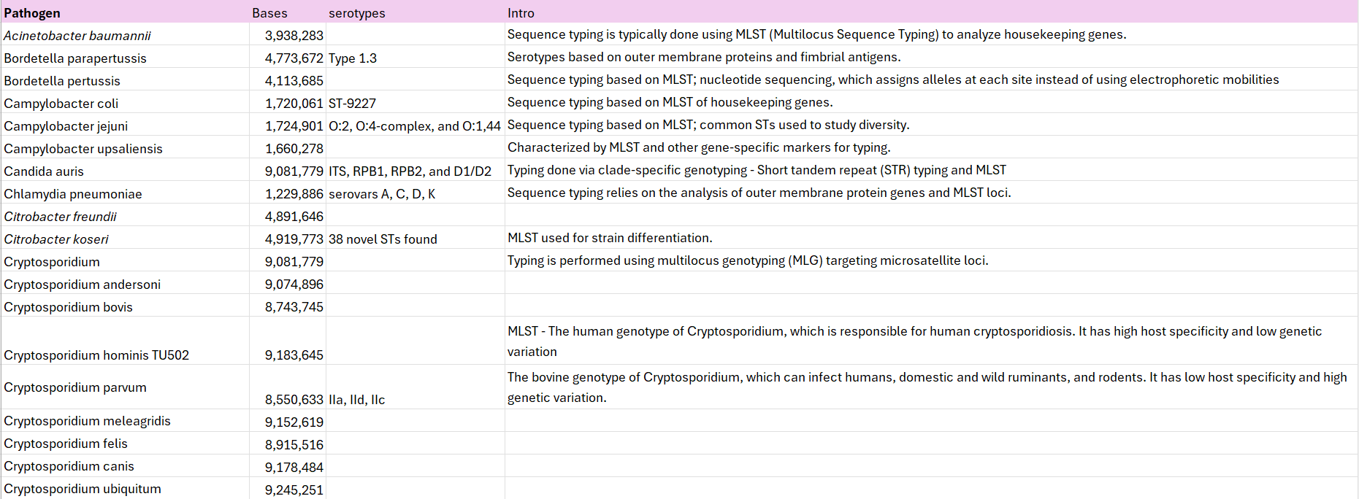

Slide 3
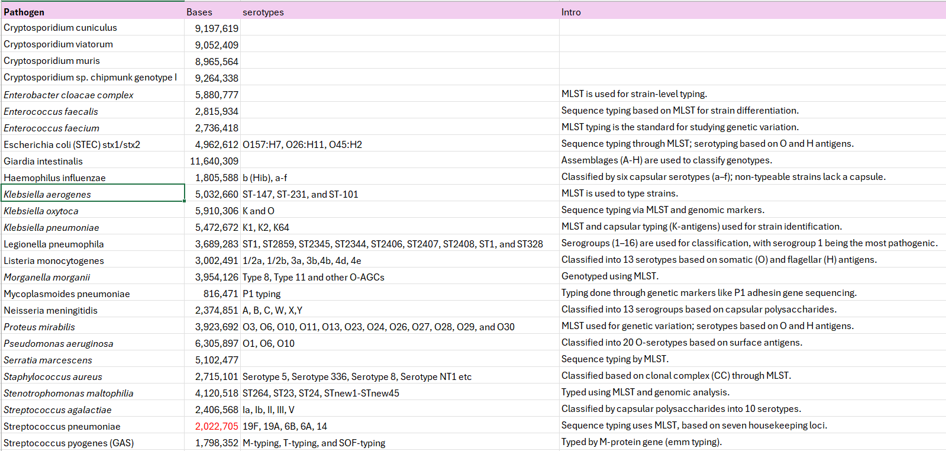

Slide 4
Loci Used for Typing Streptococcus pneumoniae
Locus: Capsular Polysaccharide Synthesis (cps) locus
Size: Approximately 15–20 kb, varying slightly depending on the serotype.
Genes: Encodes 12–18 genes that are organized into distinct functional regions.
Function: Responsible for producing the polysaccharide capsule, a critical virulence factor. The capsule protects the bacterium from host immune responses by inhibiting phagocytosis.
Number of Serotypes: Over 100 identified serotypes based on cps variations which determines the chemical structure of the capsule.
Typing Tool: SeroBA, based on genetic variation in the cps locus. This too detects genetic variations in the cps locus to predict pneumococcal serotypes directly from whole-genome sequencing data.
The capsule polysaccharide (CPS) locus, encodes the genes for the biosynthesis of the pneumococcus's polysaccharide capsule.

Slide 5
Selected Sequence typing tools
Our main focus is to predict the ST’s of Streptococcus pneumoniae. After some research and reading articles, seroBA, PneumoCaT, PneumoKITy, stringMLST, MetaMLST and PyMLST are the widely used tools. I selected SeroBA, stringMLST and MetaMLST as key tools for analysis:
SeroBA: The first 3 mentioned tools are specific to Streptococcus pneumoniae and there are several github pages that are promising as they claim that the tool works on low coverage levels ~10X and SeroBA can predict serotypes, by identifying the cps locus, directly from raw whole genome sequencing read data. This tool also has the reference databases from PneumoCaT. Therefore, I chose this tool. (seroBA, last updated 2020).
stringMLST: This is a fast and efficient tool for sequence typing bacterial species. It skips the need for full genome assembly by using a k-mer approach, which means it works directly on raw sequencing data. It’s accurate, works even with lower-quality data, and can handle multiple species. (stringMLST, last updated 2020).
MetaMLST: This is a tool designed for typing pathogens directly from metagenomic datasets, making it perfect for complex samples like wastewater, soil, or gut microbiomes. Unlike traditional MLST, it works well with mixed microbial communities, identifying specific pathogens and their sequence types (STs) without needing genome assembly. But it needs aligned files as inputs. We can also customize it for specific microbes or loci we’re interested in. (metamlst, last updated 2022).

Slide 6
Experiment 1: StringMLST
Sample Preparation:
Used wastewater samples from LA and Orange County - (6 paired-end samples). They are downsampled to 10 million reads.
Specifically talking about S.pnuemoniae, the genome assembly, NCTC11032 (assembly) was considered with genome size of 2Mb. The total bases were 2,022,705. The number of reads at each coverage level are mentioned below:
Then 1 million synthetic reads of reference genomes of 45 species of interest were generated using InSilicoSeq (read length - 150bp, model - hiseq) and spiked them into the wastewater reads.
I tested sequence typing tools on different coverage levels, therefore I downsampled synthetic reads to 1/5/10/50/70/100/200/250/300-1000X and then spiked them into waste water samples. So now I have 12 files(paired-end) for each coverage level.
Sequence Typing using stringMLST:
stringMLST: “It works well on the isolates and metagenomic samples from ≥250X coverage level.”
The recommended kmer sizes for this tool are 33 and 66.
Step1: Download the database of species of interest: stringMLST.py --getMLST -P datasets/Streptococcus_pneumoniae --species “Streptococcus pneumoniae”
Step2: Build a database based on the kmer size: stringMLST.py --buildDB -c config.txt -k 66 -P SP
The command used: stringMLST.py --predict -1 forward_reads -2 reverese_reads -p --prefix path/to/datasets -k 66
The outputs looked like: Sample aroE ddl gdh gki recP spi xpt ST
combined_OC_whole_wastewater_DNA_250 2 14 5 1 11 16 3 53
StringMLST when ran on various S.pnuemoniae assemblies with different kmer sizes(33,66), consistent results were seen from 300X coverage and above. For coverage below 200X, its generating false positives.
This tool directly identifies known sequence types (STs), making it easy to compare samples to global databases for epidemiological studies., that too only from 250X and above coverage levels. stringMLST provides precise sequence types based on MLST, enabling better tracking of pathogen spread, diversity, and antimicrobial resistance, even when serotyping cannot differentiate strains.

Slide 7
Experiment 2: MetaMLST
Sequence Typing using metaMLST:
Clone the repository: https://github.com/SegataLab/metamlst.git
This tool needs aligned bam files as input. Therefore, before aligning the raw reads against the default MetaMLST database I created a Bowtie2 index from the default MetaMLST database : metamlst-index.py -i bowtie_index
Use the index to map your FASTQ files: bowtie2 --very-sensitive-local -a --no-unal -x bowtie_index -1 forward_reads -2 reverese_reads | samtools view -bS - >alignment.bam
Run MetaMLST on the BAM file: metamlst.py alignment.bam (you can use –filter option to chose species name inorder to check alignment of that species against the raw reads)
Run MetaMLST-merge on the the metamlst.py output file : metamlst-merge.py ./output_folder
The above mentioned steps were followed for coverage levels - 1/5/10/50/70/100/200/250/300-1000X and the the tool worked from ≥200X coverage level and showed “reconstruction succesful”. And the output looks like this: NEW MLST profiles found:
ST aroE ddl gdh gki recP spi xpt Hits
100001 2 14 5 415 11 16 100001 5
100002 2 14 5 1 11 16 100001 1
Two new sequence types are found: 100001 and 100002.
aroE, ddl, gdh, gki, recP, spi, xpt: These are the loci (genes) used in MLST. For each locus, the numbers in the rows indicate the specific alleles assigned to that gene in the respective ST.
Hits: This column indicates the number of times (or frequency) a particular sequence type was identified in the dataset.
MetaMLST when ran on various S.pnuemoniae assemblies, no consistent results were seen from 200X coverage and above. For coverage below 200X, its shows low coverage.
Unlike stringMLST, this tool provides novel sequence types (STs) that were not previously documented in the MLST database. It can be used for identifying new and unique STs, which can contribute to epidemiological studies and global MLST databases.

Slide 8
Experiment 3: seroBA
Serotyping using seroBA:
The aim is to predict serotypes by identifying the cps locus, directly from raw whole genome sequencing read data with 98% concordance using a k-mer based method for coverage level as low as 10X.
I followed this github page: https://github.com/sanger-pathogens/seroba . This tool uses KMC and ariba. The formeris used for fast and efficient k-mer counting and the latter one is used for mapping reads and local assembly to confirm and validate the presence of specific genes or regions associated with serotypes. While KMC identifies potential serotypes based on k-mers, ARIBA provides a deeper, locus-specific analysis to confirm these results.
Step1: clone the repository: git clone https://github.com/GlobalPneumoSeq/seroba.git
Step2: Install the dependencies: cd seroba/ and then ./install_dependencies.sh
Step 3: Setting up a database: The database in the github mentioned above was last updated in 2020 and also the conda environment ran into several errors. The updated database is present in (https://github.com/GlobalPneumoSeq/seroba).
Docker runs well for this tool. It has a pre-built database with default kmer value 71. So we need not run additional step to build a database unless you want to go for a different kmer size.
Step 4: Command to build a different kmer size: seroba createDBs path/to/database 66
Step 5: Then run the tool using docker: docker run --rm -it -v path/to/input/files:/data sangerbentleygroup/seroba seroba runSerotyping /seroba/database forward_reads reverese_reads /data/output_folder
The tool was run on various coverage levels on various S.pnuemoniae assemblies- 1/5/10/50/70/100/200/250/300-1000X

Slide 9
SeroBA outputs:
Tried and tested seroBA on different S.pnuemoniae assemblies:
GCF_900618125.1_NCTC11032
GCF_000019825.1_ASM1982v1
GCF_026625945.1_ASM2662594v1
GCF_000007045.1_ASM704v1
GCF_024089355.1_ASM2408935v1
Two different kmer sizes were tested on these isolates - kmer - 71(default), 51 and 31. For all these different kmer sizes, the tool worked only on 500X and above coverage levels.
For coverage levels 200X to 500X- it gave ”Untypable” ot “NT”. Serotypes that do not match any reference are marked as "untypable".
For coverage levels below 200X - it stated as “coverage too low”.
The right output looks like: Predicted Serotype: 23F Serotype predicted by ariba: 23F assembly from ariba has an identity of: 99.77 with this serotype Serotype Genetic Variant 23F allele wchA
SeroBA didnot work on metagenomic samples.
Also it didnot work on low coverage levels ~10X as they claimed.

Slide 10
Experiment 4: seroBA on Global Pneumococcal Sequencing (GPS) dataset
There was an issue with how reads were downsampled earlier which caused problems for SeroBA.
The right approach:
No need to simulate an artificial number of reads from a S.pnuemoniae genome assembly. Instead use real read data for benchmarking a tool such as Global Pneumococcal Sequencing (GPS) dataset: https://data-viewer.monocle.sanger.ac.uk/project/gps and downsample them to 10k-1M reads and run the tool on those reads to check if its predicting the right serotype.
Download Reads for Benchmarking:
Identify the S. pneumoniae sample using its ERS ID from the Monocle Data Viewer.
Note that the Monocle viewer downloads .fa files for ERS IDs, which are unsuitable for SeroBA. To obtain the appropriate .fastq files:
Use the SRA ID associated with the ERS ID (e.g., ERS322334). Then, locate and download the .fastq files from the SRA NCBI database.
Once the fastq files are downloaded, create subsets by downsampling the reads to generate datasets with the following read counts:
10,000, 50,000, 100,000, 250,000, 500,000, 750,000, and 1 million reads.
These subsets should range from 1% to 100% of the total reads in the sample (e.g., 1% of 1 million reads = 10,000 reads).
Run SeroBA on Downsampled Files:
Test SeroBA on each downsampled dataset to verify whether it predicts the correct serotype.
If SeroBA successfully predicts the correct serotype for all downsampled files:
Combine each downsampled S. pneumoniae file with the downsampled reads from the LA_1 wastewater sample.
Ensure the total number of reads in each combined file is 10 million.
For example:
Combine the 10,000-read S. pneumoniae subset with 9,990,000 reads from LA_1.
Repeat this process for all downsampled S. pneumoniae subsets.
Run SeroBA on Combined Files:
Test SeroBA on the combined samples (14 in total) to check its performance.
If the tests are successful:
Repeat the process using a second wastewater sample (LA_2) and a different S. pneumoniae sample (e.g., S. pneumoniae_2).
Follow the same steps to create and test combinations.

Slide 11
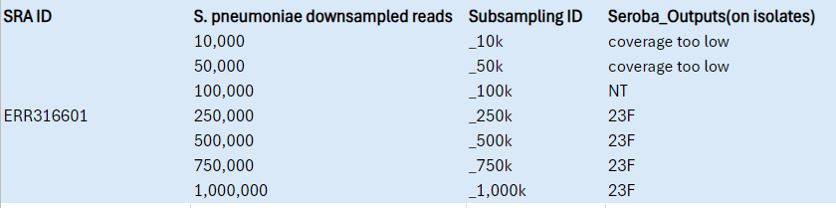
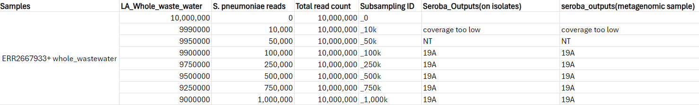
There are 2 tables below:
Table 1 contains the information of S.pneumoniae isolate, ERS ID(ERR316601) downsampled to 10k-1M reads and the seroBA tool rightly predicted the serotypes as mentioned in the seroba_outputs column. The tool couldn't predict serotype at 10k and 50k reads.It works on 100K-1M reads.
Table 2 contains the information on LA waste water sample spiked in with the S.pnuemoniae isolate, ERS ID(ERR316601) in a way that the total reads should make up to 10M reads. The tool gave the same outputs as it gave for the isolates.
I repeated the above steps for 4 more S.pnuemoniae isolates spiked into different waste water samples and got the right results for 100K reads and above. Therefore, the tool works effectively on the metagenomic samples with reads 100k and above and rightly predicts the serotype.

Slide 12
SeroCall (GitHub - knightjimr/SeroCall: Pneumococcal serotype quantification using NGS reads)
SeroCall can identify and quantitate the capsular serotypes in Illumina whole-genome sequencing samples of S. pneumoniae, calculating abundances of each serotype in mixed cultures.
SeroCall has the following dependencies:
Python 2.7+ or 3+ (tested using 2.7.11 and 3.5.1), BWA version >= 0.7.15, Samtools version >= 1.3 (only used if you change/update the reference database files)
To install SeroCall, download or clone this github repository, then add the SeroCall directory to your PATH environment variable – git clone https://github.com/knightjimr/SeroCall.git
Command used to run: python3 serocall inputfile1 inputfile2 –t threads –o path/to/outputfolder (use python2 or python3 depending on the version installed) and it can take both compressed and uncompressed fastq files as input.
SeroCall will generate two output files, a *_counts.txt containing the intermediate "bin" counts, counting how many reads aligned across the regions of the serotype references, and a *_calls.txt containing the final calls.
The ‘calls.txt’ file will call the predicted serotypes. The ‘counts.txt’, an intermediate file, but can be useful for post-analysis QC of the calls
*NOTES*
The current software has pre-built databases containing the same serotype sequences as the PneumoCaT v1.2 database, and building the database is not required in order to use the serocall command. The package does provide the ability to change and update the references used by SeroCall, but this has not been extensively tested.
The builddata sub-directory contains the data files and scripts necessary to rebuild the SeroCall database files (found in the "data" sub-directory of the repository). In that sub-directory, the serotype capsular sequences are found in the "serotypes" sub-directory, the S. pneumoniae references are found in the "genomes" sub-directory and the difference locations are found in the "pcat_diffs.txt" file.
To add a new serotype capsular sequence to the database, follow add new serotype to database.
To add a new genome reference to the database, follow add new genome reference to database.)

Slide 13
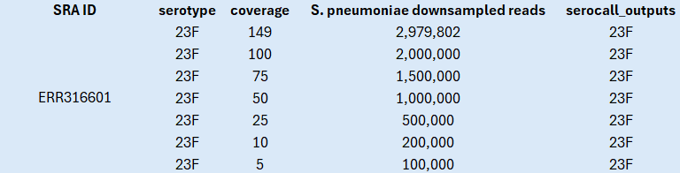
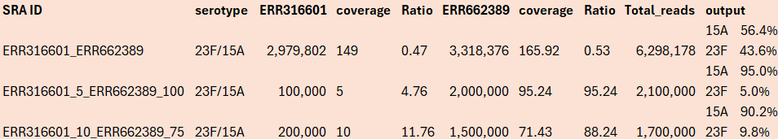
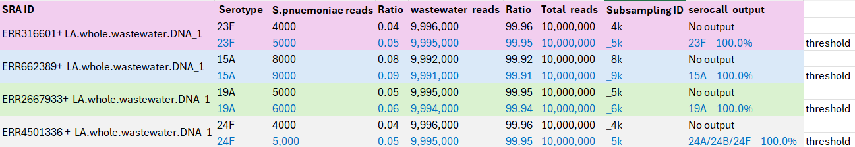
Experiment
Table 1: serocall tested on s.pnuemoniae reads based on 5X-100X coverage
Protocol for Evaluating Tools:
1. Downsampling of Known Subtypes (Single Isolate):
Subsets of 100k to 2M reads were generated based on coverage levels ranging from 5X to 100X. The tool was tested using these subsets, and as shown in Table 1, it accurately predicted the correct serotype even at 5X coverage.
2. Mixing Different Ratios of Multiple Subtypes:
Two, three and five different samples were mixed in varying proportions. Coverage ratios were adjusted, such as 4.76% of 5X coverage combined with 95.24% of 100X coverage. The tool was able to correctly predict the serotype in all cases, as presented in Table 2.
3. Downsampled reads Mixed with Wastewater (Single Isolate):
Subsets ranging from 1k to 1M S.pnuemoniae reads were generated, with coverage levels from 0.05X to 50X.
These subsets were mixed with wastewater reads to create a total dataset of 10 million reads. The tool’s performance varied across different samples, as shown in Table 3.
For ERR316601 + Wastewater, the tool failed to predict the serotype when ERR316601 reads were below 5000 (0.05% of the total sample). For ERR662389 + Wastewater, the threshold was higher, with failure occurring below 9000 reads (0.09% of the total sample).
Table 2: serocall tested on different ratio mixes of multiple subtypes based on 5X-100X coverage
Table 3: serocall tested on different ratio mixes of single isolates with wastewater reads

Slide 14
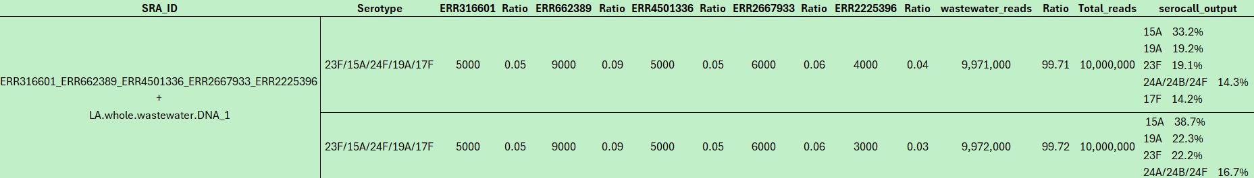
Table 4: serocall tested on different ratio mixes of single isolates with wastewater reads
Mixing Different Ratios of Multiple Subtypes with Wastewater Reads:
Two, three, and five different samples were mixed in varying proportions with wastewater reads, totaling 10 million reads, as shown in Table 5.
I conducted two different experiments:
In the first experiment (Table 4), the threshold for detecting serotypes in a single isolate mixed with wastewater varied across samples. For ERR2225396 + wastewater, the threshold was 4,000 reads, while for ERR2667933 + wastewater, it was 6,000 reads. The tool was tested on these threshold-level reads mixed with wastewater to reach a total of 10 million reads, and it successfully identified the correct serotypes.
In the second experiment, five mixed subtypes were combined with wastewater. The tool accurately predicted serotypes when the reads met the threshold level but was unable to identify the specific serotype for a sample when its reads fell below the threshold as mentioned in Table 5 and Table 6.
Based on these patterns, Serocall outperforms all other tested tools, as it can accurately predict the correct serotypes even with as few as 5,000 reads when mixed with wastewater. This demonstrates the tool's reliability and confidence in serotype identification.
Table 5: serocall tested on different ratio mixes of 4 multiple subtypes with wastewater reads
Table 6: serocall tested on different ratio mixes of 2 multiple subtypes with wastewater reads

Slide 15
Loci Used for Typing Streptococcus pyogenes
Locus: emm locus
Size: Approximately 1.5–2.0 kb, varying depending on the emm type.
Genes: The emm locus primarily encodes the M protein, a surface protein and major virulence factor of S. pyogenes.
Key genes within or near the emm locus include:
scpA: Encodes C5a peptidase (immune evasion).
mrp: Encodes an M-related protein.
enn: Encodes another M-like protein that binds IgG.
Function: The M protein is a major virulence factor that:
Prevents phagocytosis by inhibiting complement deposition.
Promotes adhesion to host cells.
Evades host immune responses by molecular mimicry.
Number of Types: There are over 250 emm types of S. pyogenes, classified based on sequence variability in the emm gene. These emm types are associated with different infection profiles, including pharyngitis, cellulitis, and invasive infections.
Typing Tool: Emm-Typing Tool (CDC or UKHSA tools):
Uses emm gene sequence variability for typing directly from genome sequencing or PCR-based approaches.
Typing is based on the N-terminal hypervariable region of the emm gene.

Slide 16
Additional Notes
Strains of GAS were typed based on a serological reaction against M protein. In addition to gene emm, some GAS strains may possess up to two additional emm-like genes, also known as mrp and enn, which encode M-like proteins designated Mrp and Enn, respectively.
The first gene of this discrete chromosomal region is mga and the last gene is scpA, encoding a cell wall-associated C5a peptidase.
In GAS types with only emm, this gene is found immediately downstream of mga. In strains with both emm and emm-like genes, mrp is found downstream of mga, followed by emm and then by enn.
The article https://pmc.ncbi.nlm.nih.gov/articles/PMC4042799/ explains how WGS can improve the typing of Group A Streptococcus (GAS). Traditional typing methods, like emm typing (based on the emm gene) and MLST (using multiple genes), help track and control outbreaks.
Using WGS, researchers analyzed 191 GAS genomes representing 42 emm types. They found that WGS, combined with the SRST2 tool, accurately identified most emm and sequence types. However, challenges arose from emm-like genes (mrp and enn) and errors in the CDC's emm database, leading to ambiguities. A custom pipeline using BLAST and assembly resolved these issues.
WGS also detected strains with emm gene deletions missed by traditional typing and identified key genes linked to infection sites. The study concludes that WGS is faster, more detailed, and compatible with older methods, but accurate databases are critical for success.
SRST2 identifies Group A Streptococcus (GAS) strains by analyzing WGS data. It compares the short reads to reference databases, including the emm gene database for emm typing and the MLST database for sequence typing (ST).
SRST2 maps the reads to these references, scores the matches based on how well they align, and determines the most likely emm type and sequence type. If multiple high-scoring matches occur due to similar emm-like genes (like mrp or enn), further tools like BLAST or gene position analysis can clarify the correct type. SRST2 also checks for specific virulence genes, providing a fast and accurate way to type GAS strains and ensure compatibility with traditional methods like emm typing and MLST.

Slide 17
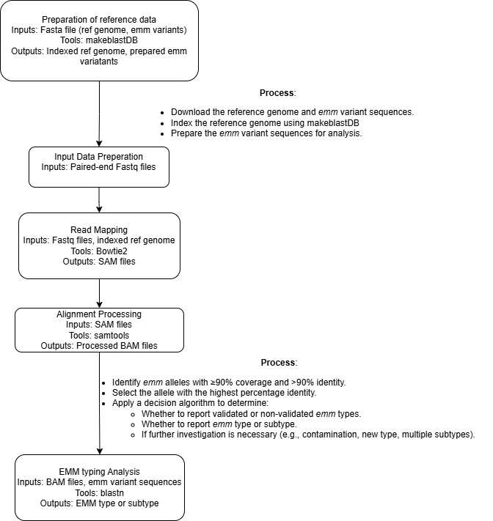
Selected tools for emm typing
Workflow for EMM Typing Tool: (https://github.com/ukhsa-collaboration/emm-typing-tool)
The emm-typing-tool is designed to determine the emm type and subtype of Streptococcus pyogenes by analyzing next-generation sequencing (NGS) data.
It primarily accepts paired-end FASTQ files as input, which contain raw sequencing reads.
These reads are mapped to a reference database of emm variants using Bowtie2. The tool does not natively support assembled contigs as input.
The reference sequences are indexed using makeblastdb, a tool that prepares them for alignment and comparison.
Sequencing reads are mapped to the reference emm variants using Bowtie2.
Process mapped reads with Samtools to refine alignments.
The pipeline identifies emm types or subtypes based on the best match to the reference database and generates the final results.
EMM typing is done based on identifying emm alleles with ≥90% coverage and ≥90% identity from mapped reads and chose allele with the highest percentage identity. The emm type or subtype is reported based on the allele analysis i.e If only one emm allele passes the above mentioned criteria, it is reported as the emm type. If multiple alleles pass, additional analysis is performed to resolve ambiguities (e.g., contamination, new types, or mixed subtypes).

Slide 18
Experiment
The Steps followed:
git clone https://github.com/ukhsa-collaboration/emm-typing-tool
Installed required dependencies: Samtools – 0.1.19 (only this specific version works), Mosaik, Python - 2.7.5, Biopython – 1.76, blast+, emboss, numpy, PyYaml, lxml
Downloaded reference sequence (AE004092.2; Streptococcus pyogenes M1 GAS)in fasta format and index the reference sequence by using makeblastdb.
The EMM_determiner_functions.py uses a pre-existing database of emm variants in the form of FASTA files - emm_tsdna.fas - this file is obtained by downloading alltrimmed.tfa file from CDC M-type specific database (ftp.cdc.gov - /pub/infectious_diseases/biotech/tsemm/) and renaming it to emm_tsdna.fas.
The next step is to blast the emm variant sequence against reference.seq using blastn to identify flanking regions of emm loci in the reference genome and then concatenate those flanking sequences with emm variants to prepare for alignment to create a final indexed reference.
The function prep_SRST does this in the script. Then reads are mapped using bowtie2 where reads from our sample are aligned to this prepared reference containing all the known emm variants. This outputs a temporary SAM file, converts it to BAM , sort and index.
With the function pileupReads, the script generates base-level alignment information to assess coverage and sequence variants from the BAM file. Then the score function is used that determines the most likely emm type based on coverage, depth, and variation metrics in the output EMM_log.txt file. The SAM/BAM and index files are temporary that are removed.
Results:
I tested the tool on 10 samples (SRR1106031, SRR1106032, SRR1106034, SRR1106033, SRR1106030, SRR1106025, SRR1106026, SRR1106028, SRR1106029) by downsampling the reads to various coverage levels: 5X, 10X, 25X, 50X, 75X, and 100X.
The command used to run:
emm_typing.py -m emm-typing-tool -1 path/to/R1file -2 path/to/R2file –o output folder
The tool successfully predicted emm types at coverage levels of 25X to 100X for all samples.
The tool gives metrics for both EMM_validated and EMM_NonValidated alleles as shown below:
SRR1106030_R1 EMM_validated emm101.0.sds indels: 0 SNPS: 0 mixed: 0
SRR1106030_R1 EMM_nonValidated emm156.1.sds indels: 0 SNPS: 2 mixed: 0
While it was able to predict emm types at 5X and 10X for some samples, the low coverage levels did not provide sufficient reads to confirm the predicted emm type with confidence, as they did not meet the required coverage thresholds. The output looks like this:
SRR1106029_R1_downsample_10 EMM_validated Failed:emm115.0.sds indels: 0 SNPS: 0 mixed: 0
SRR1106029_R1_downsample_10 EMM_nonValidated Failed:emm156.1.sds indels: 0 SNPS: 2 mixed: 0
The tool demonstrates excellent performance across all samples and confidently predicts the correct emm types for Streptococcus pyogenes.

Slide 19
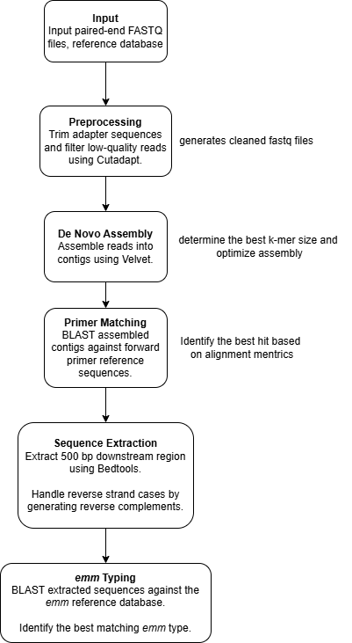
This emm_typer.pl script is a bioinformatics pipeline for emm typing, which is used for the molecular identification of Streptococcus pyogenes strains. The emm gene encodes the M protein, a key virulence factor in S. pyogenes.
The pipeline processes paired-end FASTQ sequencing data to identify and type emm alleles by leveraging de novo assembly, sequence alignment, and BLAST analysis.
It then removes sequencing adapters and trims low-quality bases from the paired-end reads and ensures only high-quality reads are processed.
The pipeline uses velvet assembler and assembles the trimmed reads into contigs for downstream analysis.
First uses velvetk.pl which estimates the best k-mer size for optimal assembly and
VelvetOptimiser.pl that performs assembly of the trimmed reads and outputs contigs.
The script performs two BLAST searches
BLAST Against Forward Primers: Identifies the contig containing the emm region.
Bedtools extracts a 500 bp region downstream of the matched primer that handles reverse strand matches.
As mentioned earlier, BLAST matches the extracted 500 bp region against a comprehensive emm gene reference database to determine the allele type.
Matches are ranked based on bit score (alignment quality), percent identity (sequence similarity), and alignment length (completeness of the match). For forward primer BLAST, a valid match requires ≥94.5% identity and a 19 bp alignment length, while emm BLAST requires 100% identity and a full-length 180 bp match. The best-scoring alignment is selected, and matches below these thresholds are flagged for review. This ensures accurate and reliable emm allele identification.
Workflow for emmtyper
https://github.com/BenJamesMetcalf/GAS_Scripts_Reference

Slide 20
Experiment
Steps followed:
git clone https://github.com/ukhsa-collaboration/emm-typing-tool.git
Install dependencies – Perl version 5.12.3, NCBI blast version 2.2.29, BEDTools 2.17.0, Python 2.7, Bio Perl, Zilla
Add paths to system $PATH.
I tested the tool on 9 samples (SRR1106031, SRR1106032, SRR1106034, SRR1106033, SRR1106030, SRR1106025, SRR1106026, SRR1106028, SRR1106029) by downsampling the reads to various coverage levels: 5X, 10X, 25X, 50X, 75X, and 100X.
The command used to run:
./emm_typer.pl -1 path/to/R1file -2 path/to/R2file -r path/to/reference_db -o path/to/output_folder -n filename
The tool predicted the right emm type for all the coverage levels – 5X-100X, but only for 5 samples.
For the rest of the 4 samples, I get this error:
name of best hit against the emm forward primers: NODE_694236_length_31_cov_2.064516
% identity of best hit against the emm foward primers: 100.000
length of best hit against the emm forward primer: 13
The best blast hit (NODE_694236_length_31_cov_2.064516) obtained from querying the assembled contigs against the emm forward primers didn't meet minimum criteria of length and identity to call a true match.
Reason: The error occurred because the best BLAST hit against the forward primers did not meet the minimum criteria for length and identity defined in the script. The match had a length of 13 bp, which is below the required minimum alignment length of 19 bp. Since the alignment length is critical for determining a valid match to the emm primers, the script flagged the result as invalid and could not proceed further.

